Slide 1
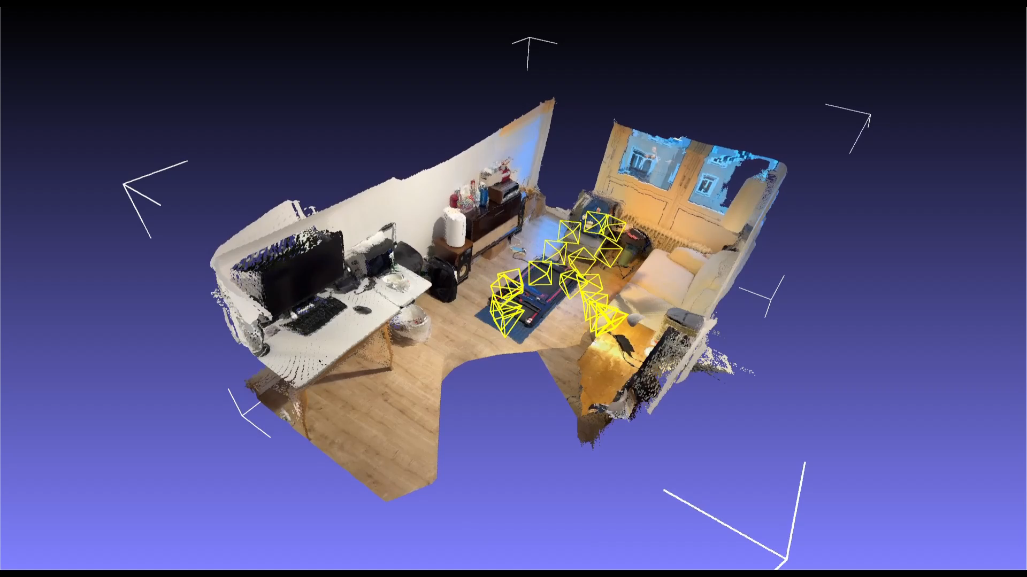
3DSMC – KinectFusion (Team 9)
Xuyuan Han
Mohamed Kotb
Feng Yang
Shengchao Zhang
Technische Universität München
School of Computation, Information and Technology
Lehrstuhl für Visual Computing
München, 13. February 2024

Slide 2
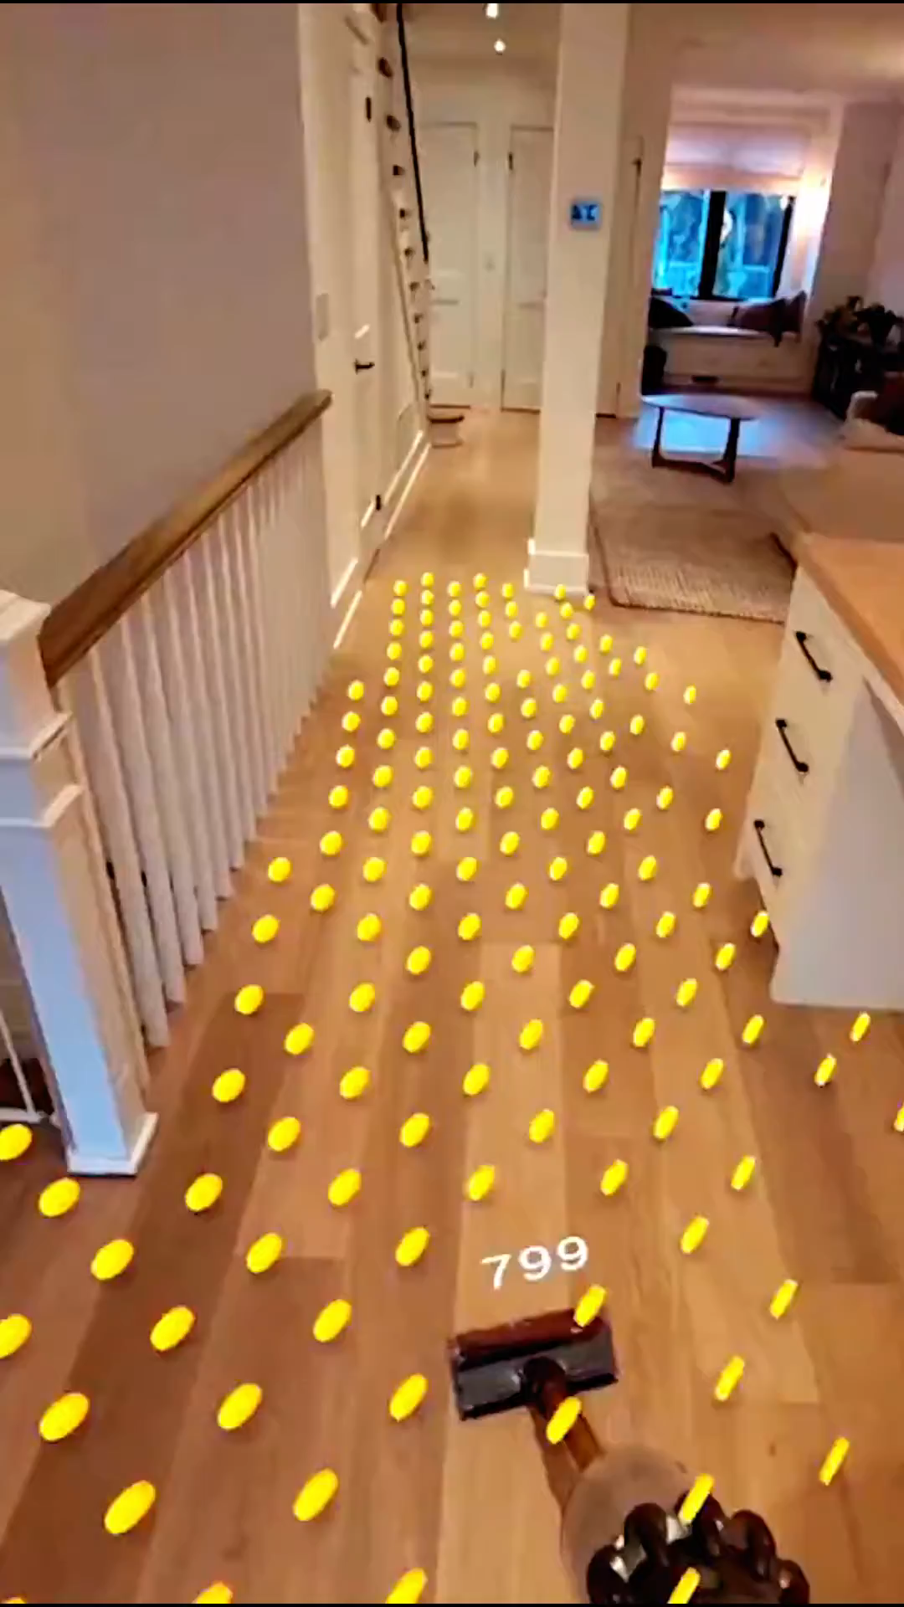
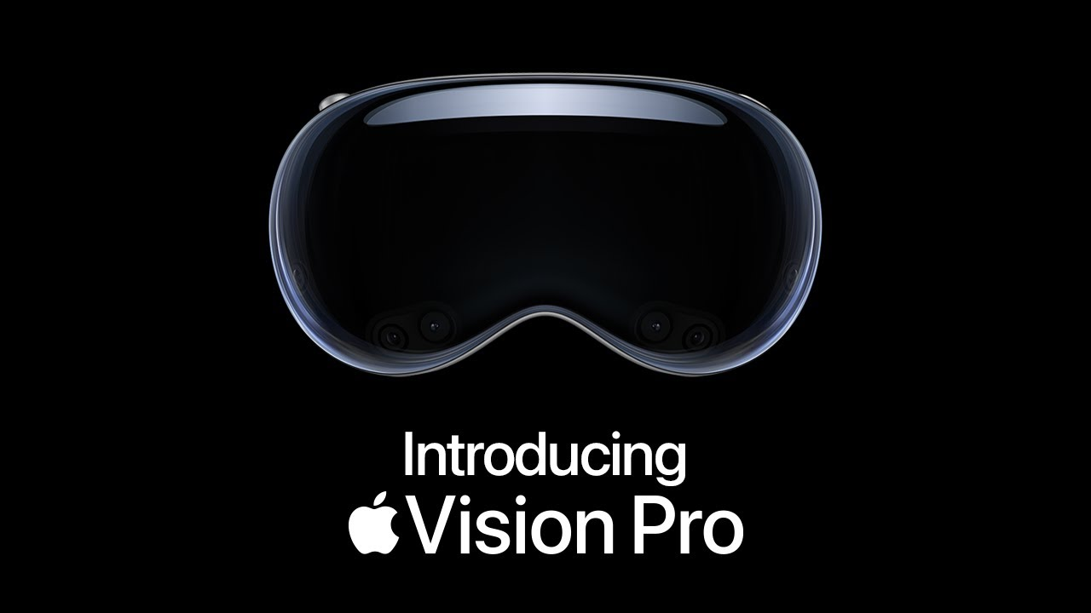
Motivation
AR & Surface Reconstruction
https://www.youtube.com/shorts/Y3dameqz_tE
https://www.apple.com/apple-vision-pro/

Slide 3
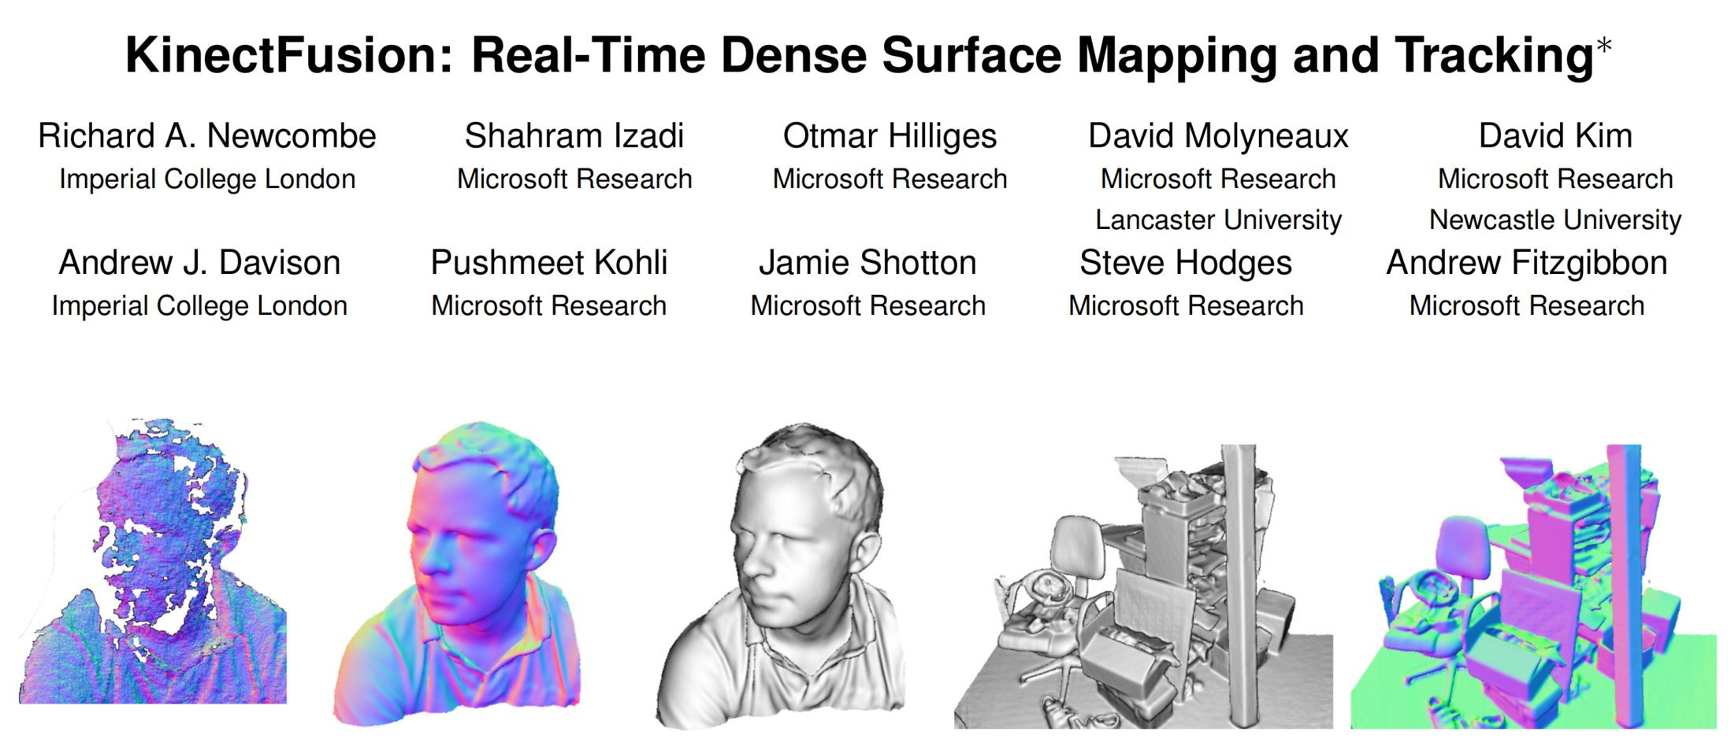
Related work
Occupancy Mapping in robotics
updating probabilistic grids iteratively via Bayesian inference
Signed Distance Fields (SDF)
revolutionized partial depth frame fusion
Bayesian probabilistic inference
straightforward algorithms for optimal surface reconstruction

Slide 4
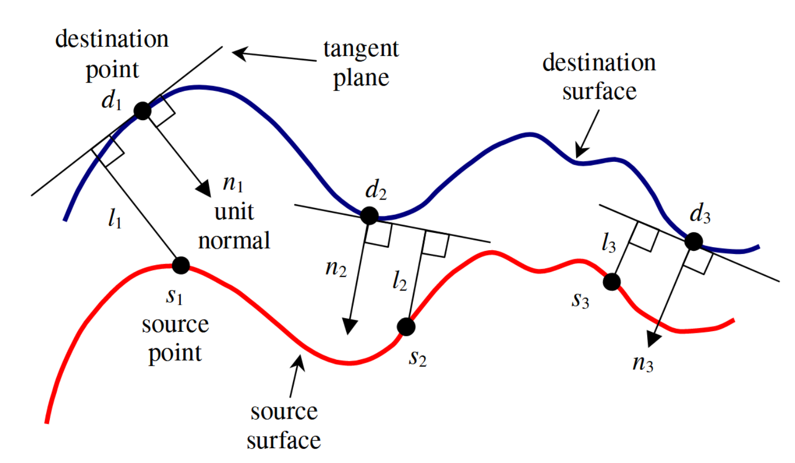
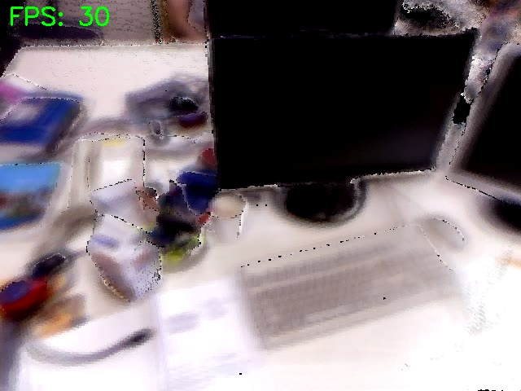
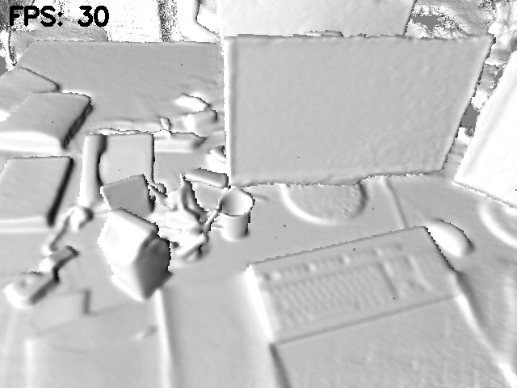
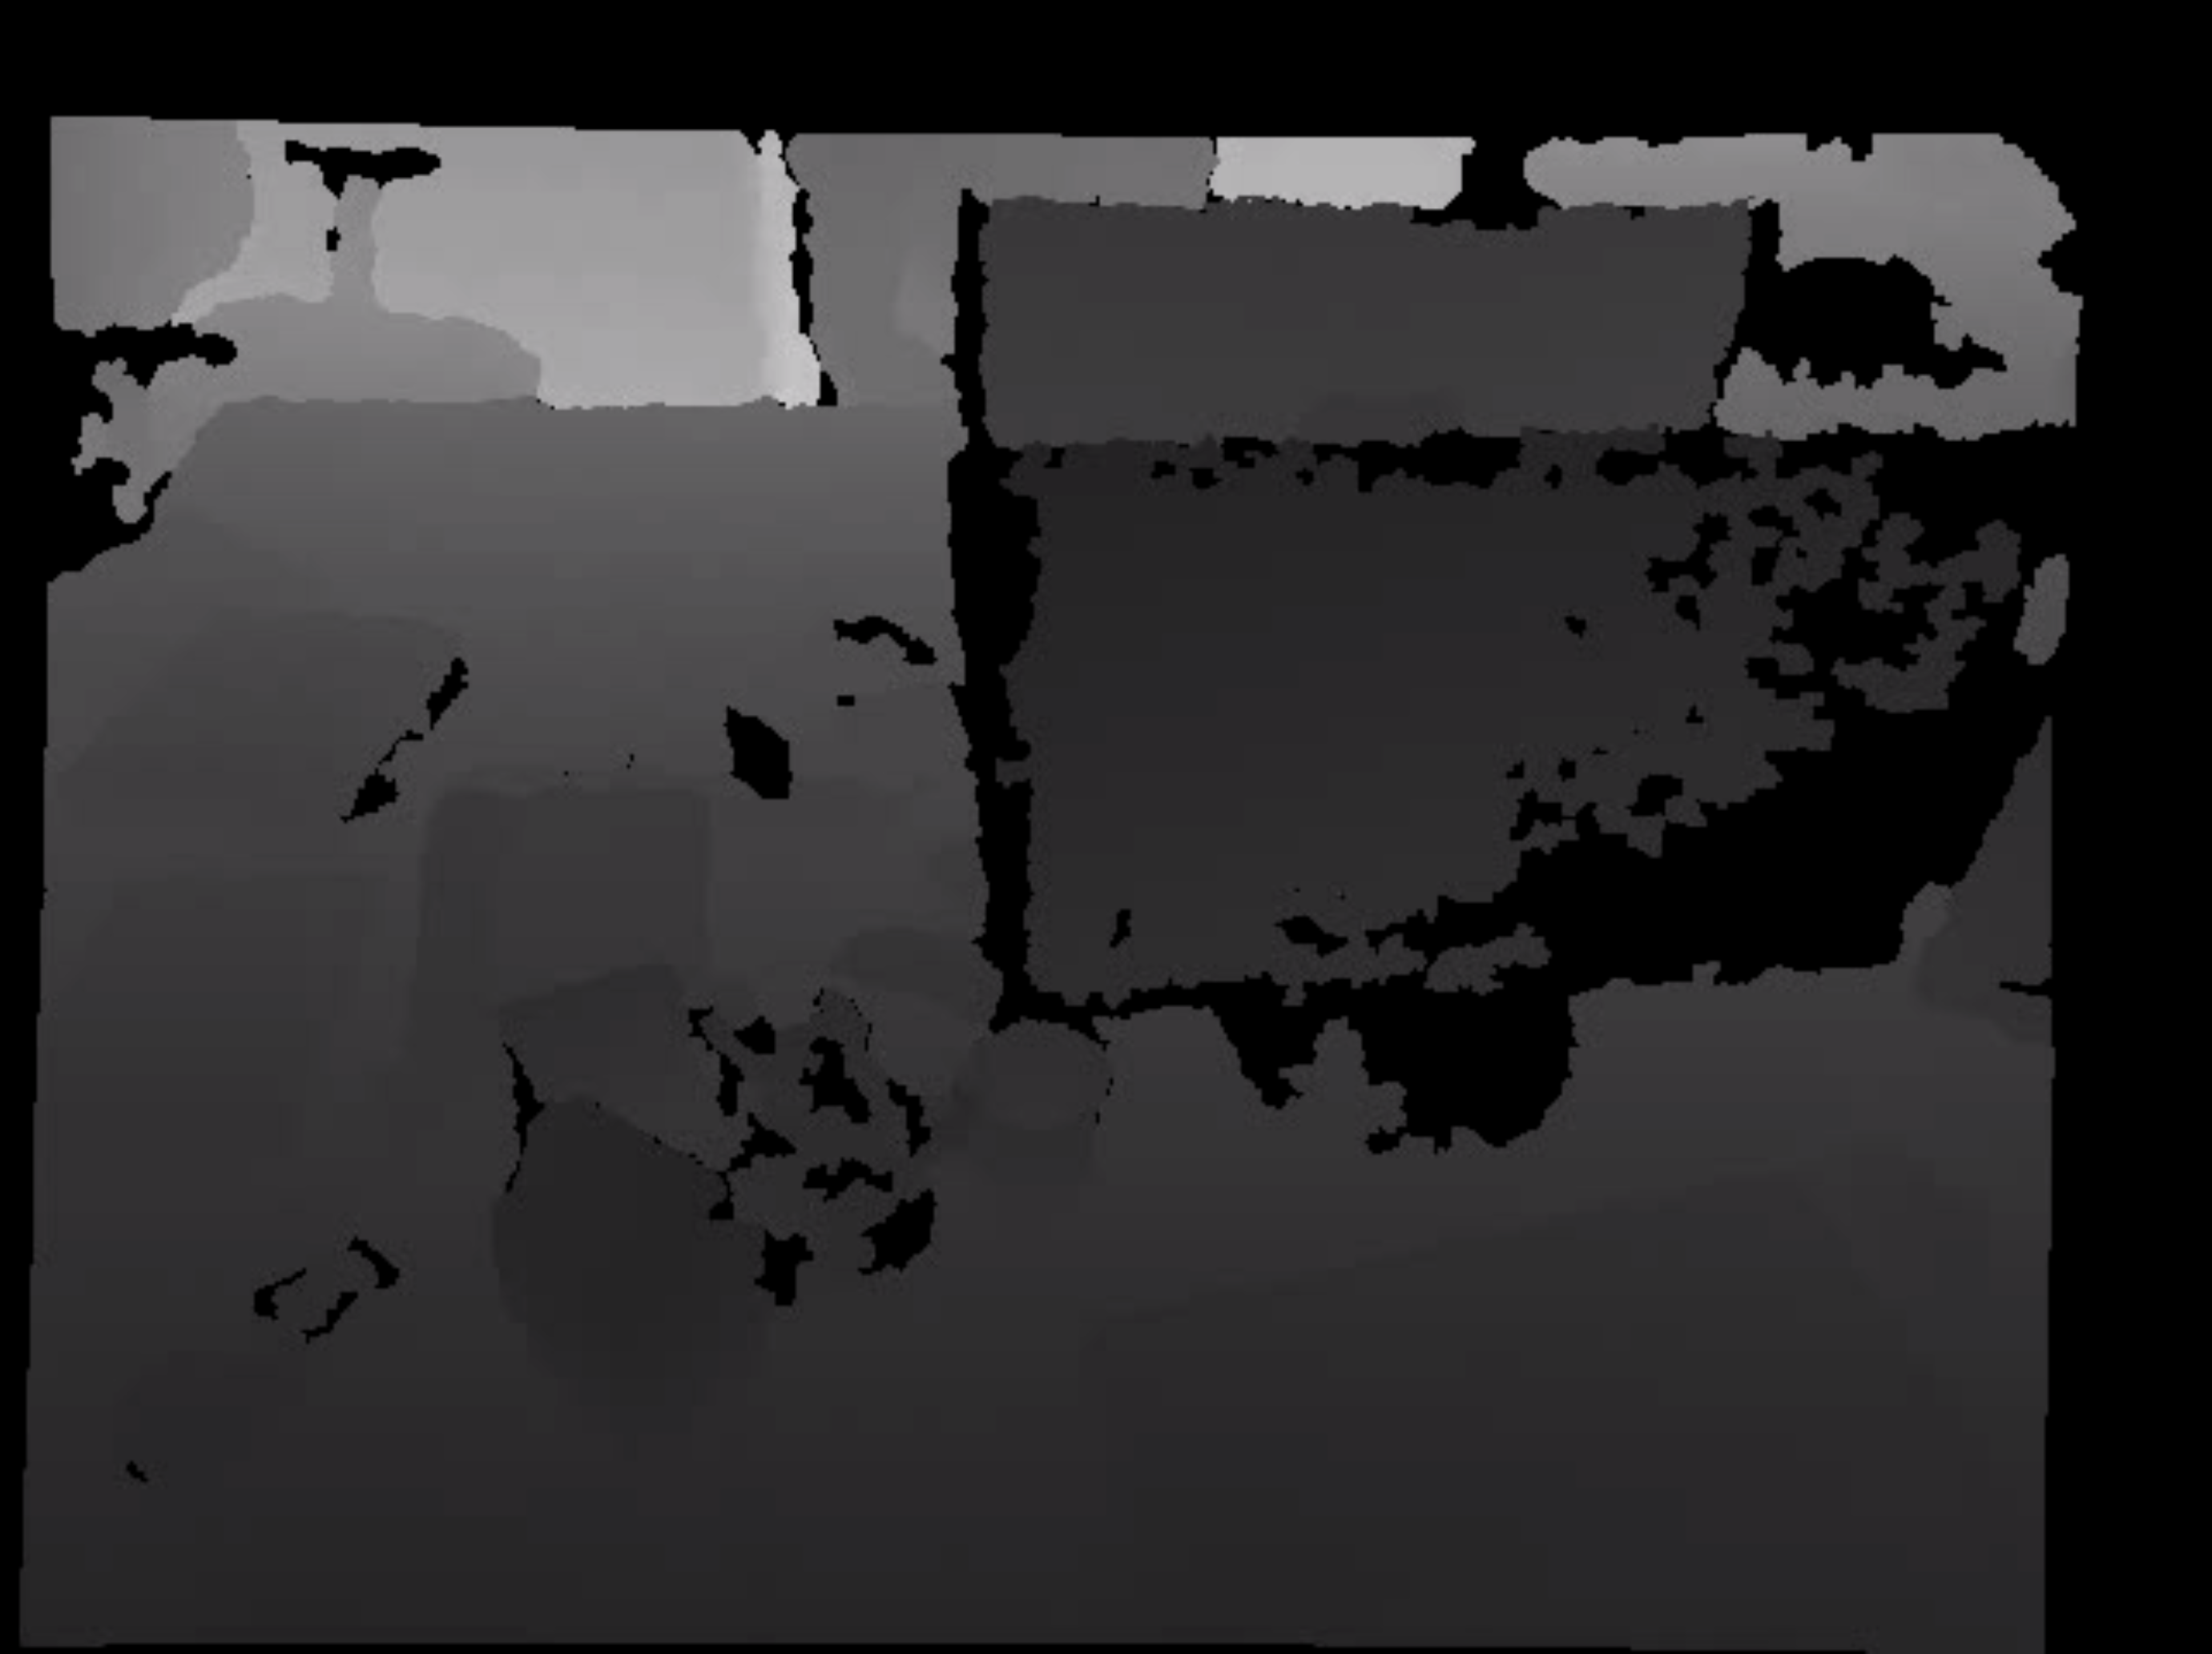
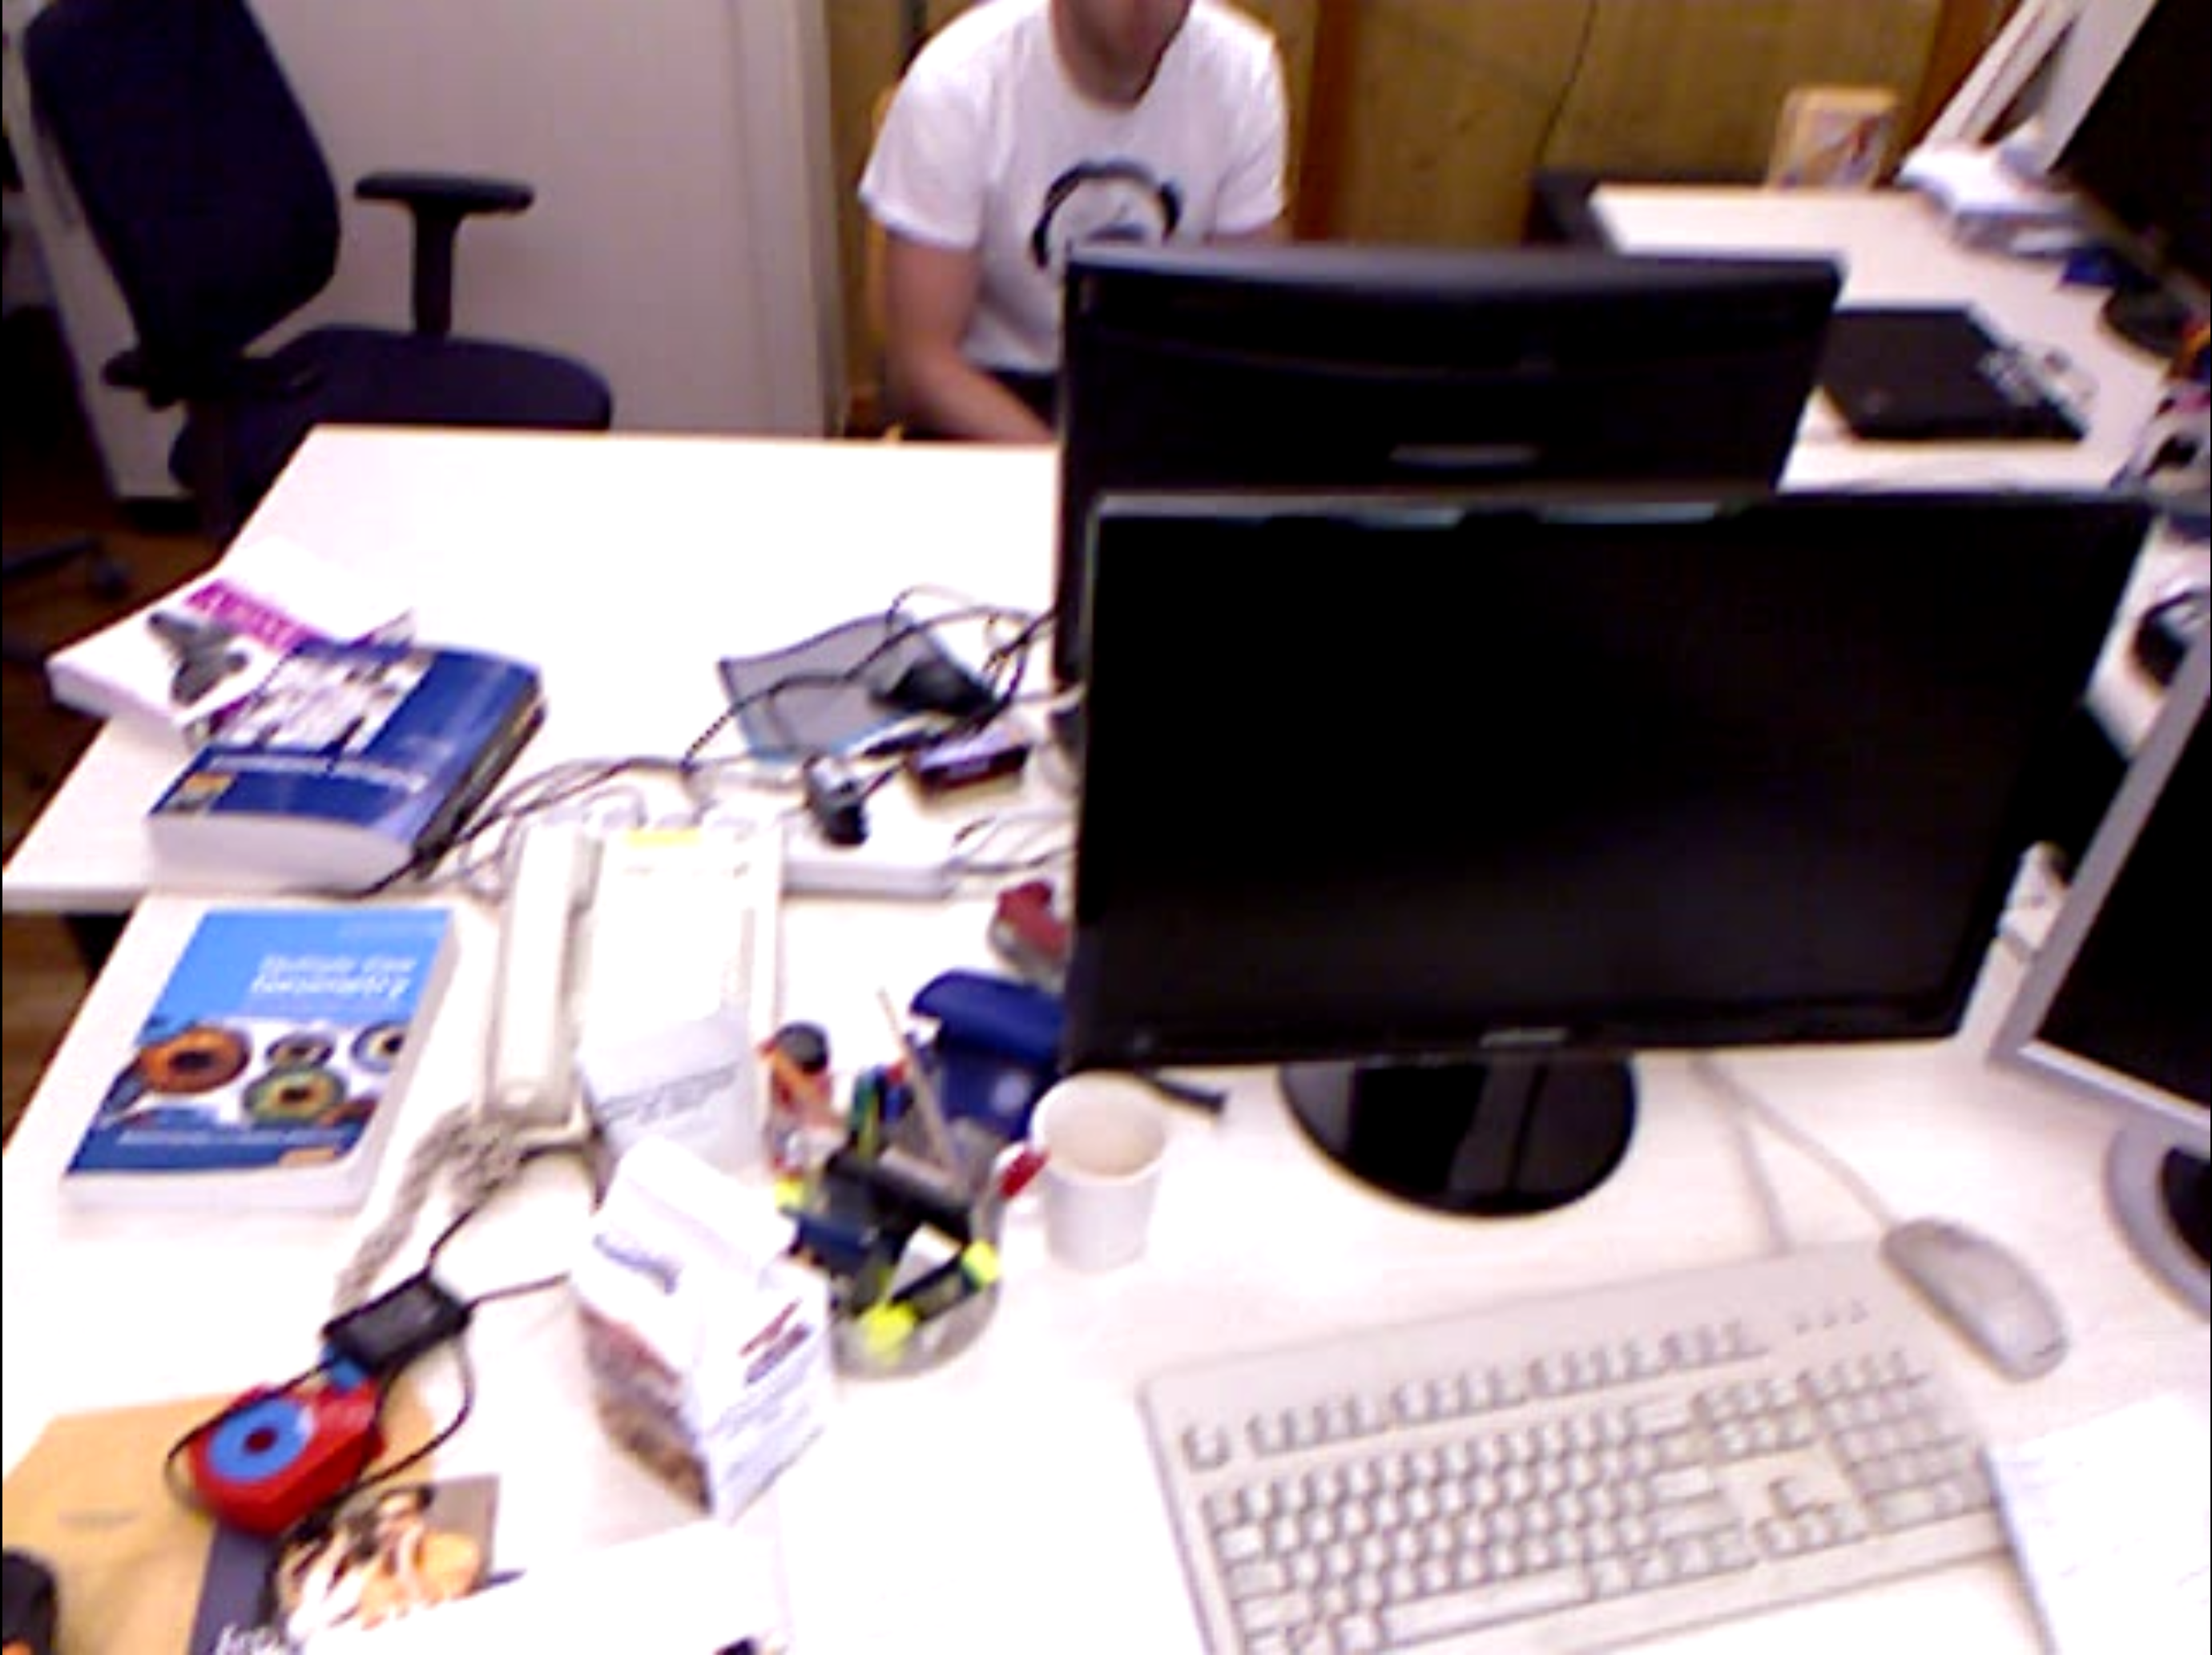
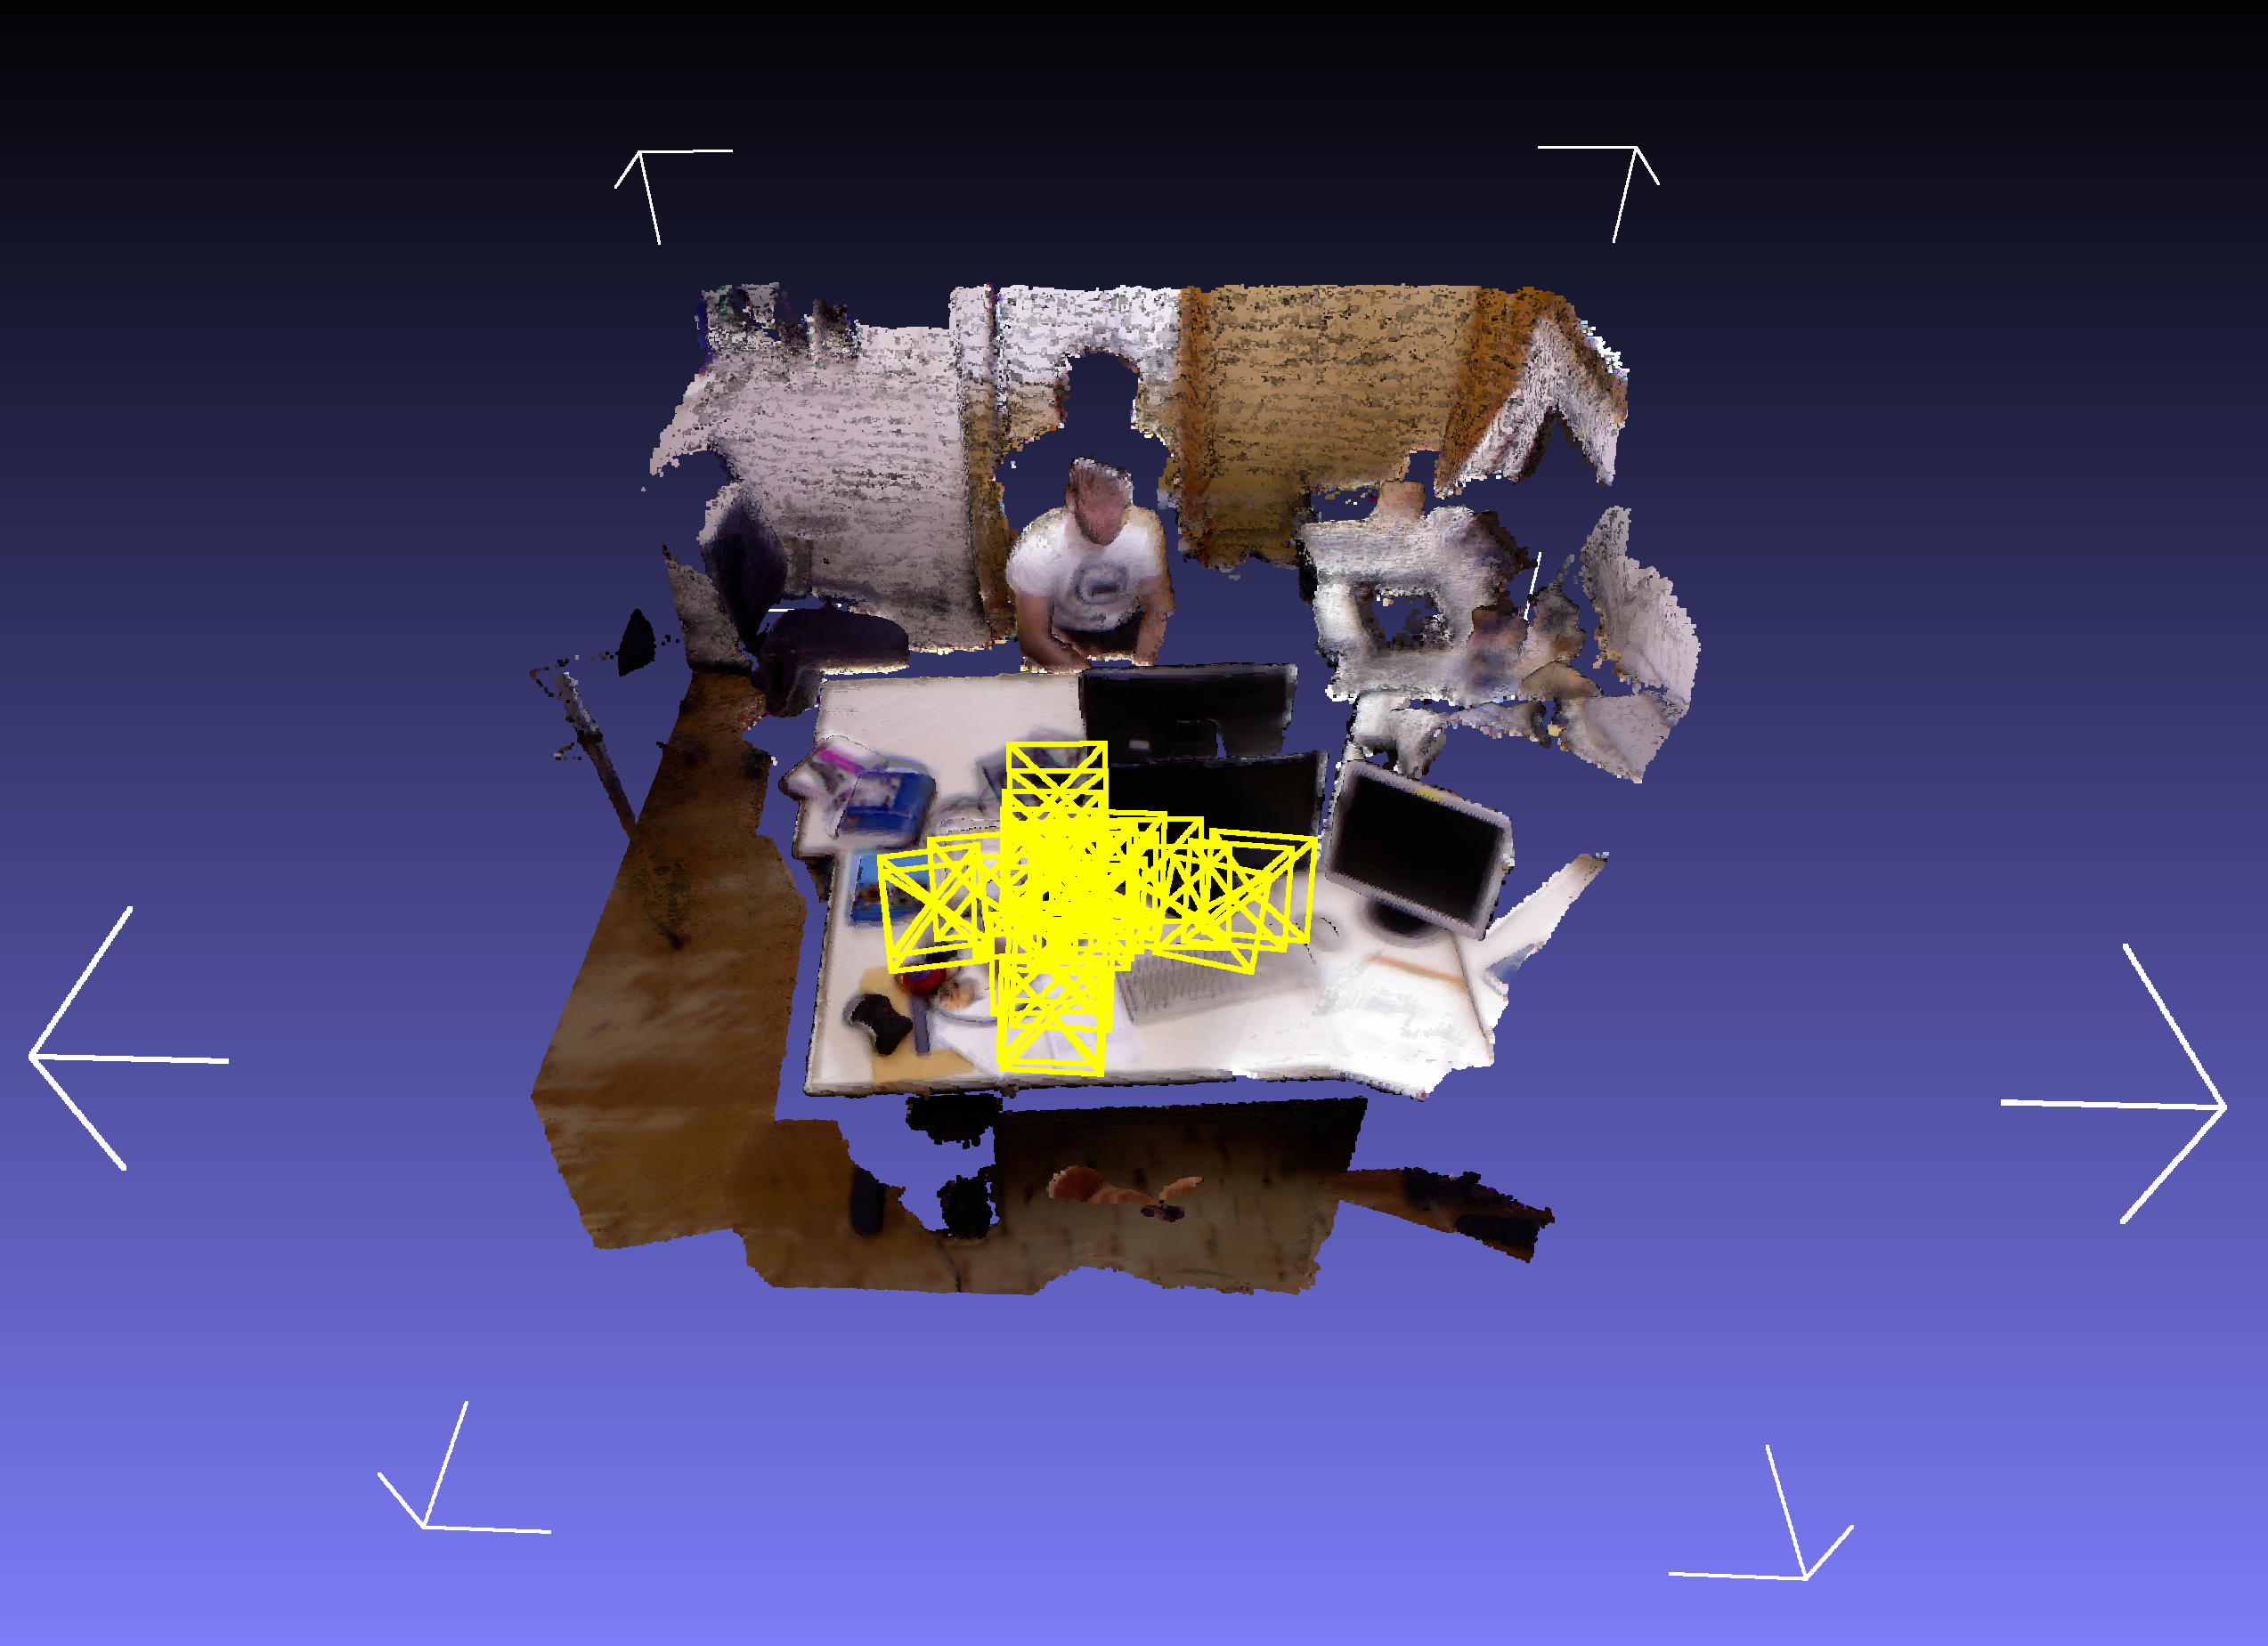
Method – Overview
1. Surface
measurment
4. Pose
estimation
3. Surface
prediction
2. Surface
reconstruction
We implemented KinectFusion on
CPU
GPU (CUDA)

Slide 5
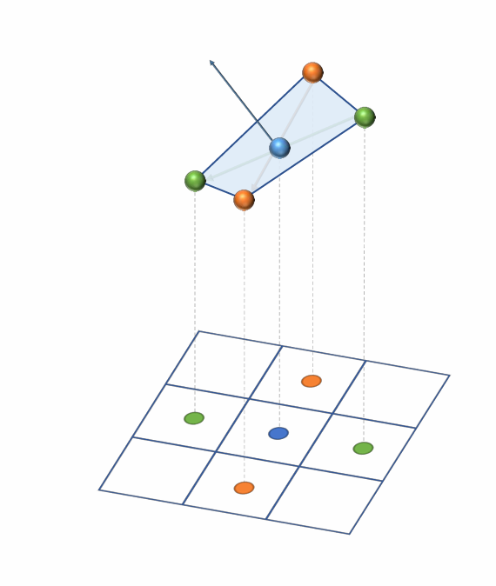
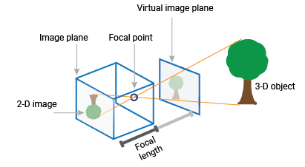
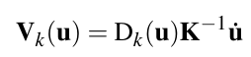
Method – 1. Surface Measurement
RGB pyramid
Vertex pyramid
Normal pyramid
Normal Computation

Slide 6
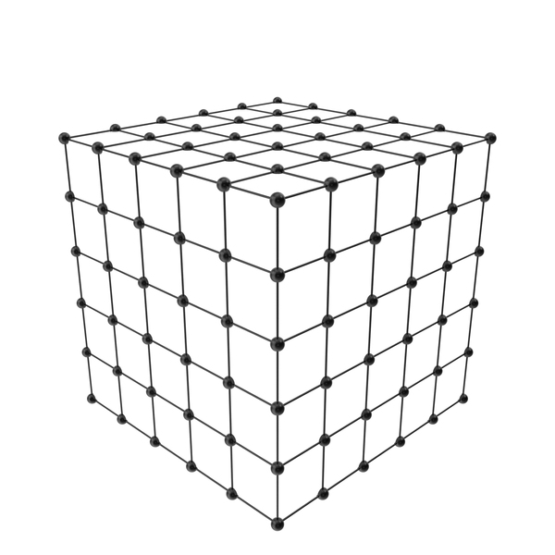
Method – 2. Surface Reconstruction
Depth Frame
Pose
Global TSDF volume

Slide 7

Method – 2. Surface Reconstruction
Measured depth ≈ Observed depth
surface
Camera
Observed depth
Global TSDF volume
Measured depth < Observed depth
Measured depth > Observed depth

Slide 8
Method – 3. Surface Prediction
for each image in image pyramid
per-pixel raycasting
surface: ray march finds zero crossing
end
Image coordinates
TSDF
value
end
0
start
start
TSDF & Color Volume
image
volume

Slide 9
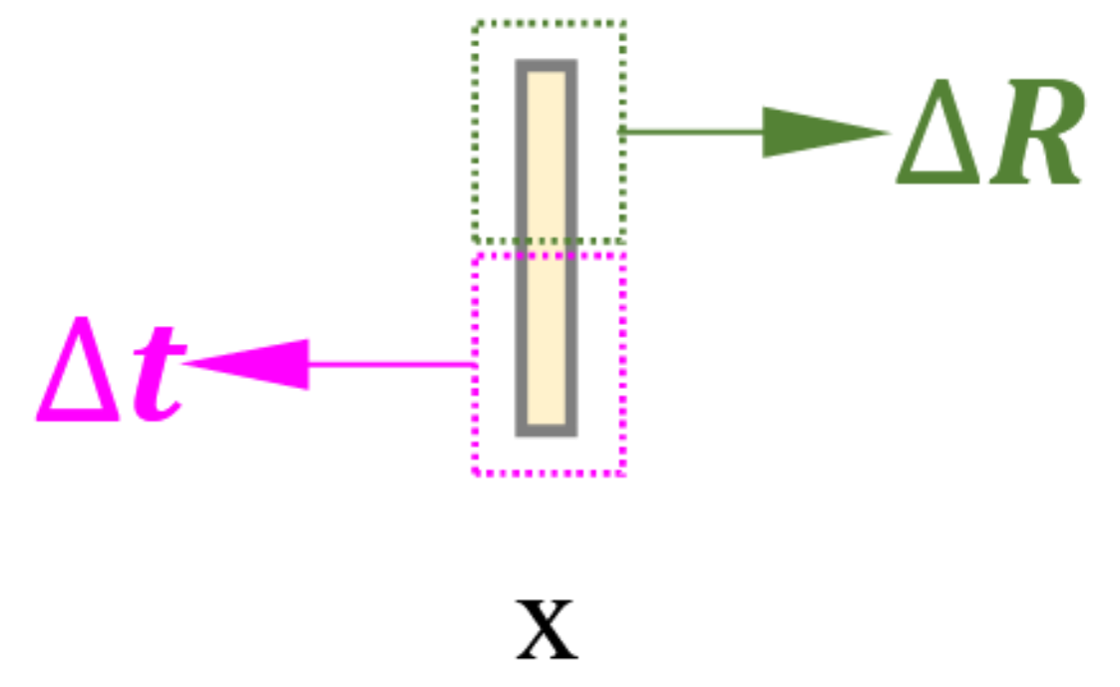
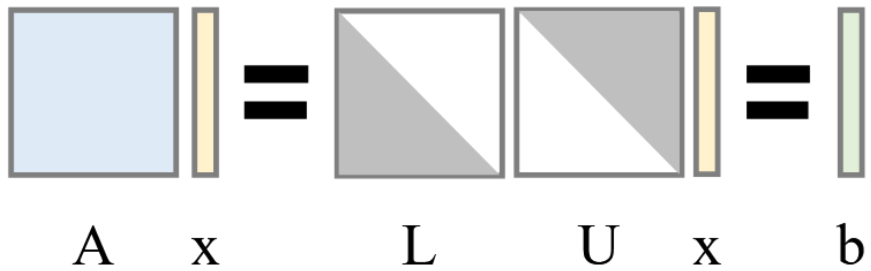
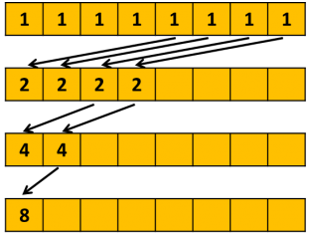
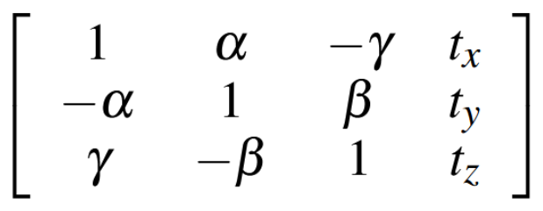
Method – 4. Pose Estimation
current vertex & normal map
(surface measurement)
find correspondence
LU decomposition
rotation & translation increment
predicted vertex & normal map
(surface prediction)
point-to-plane ICP
Low, Kok-Lim. "Linear least-squares optimization for point-to-plane icp surface registration." Chapel Hill, University of North Carolina 4.10 (2004): 1-3.
GPU reduction / CPU summation
https://developer.nvidia.com/blog/faster-parallel-reductions-kepler/
update camera pose

Slide 10
Results

Slide 11
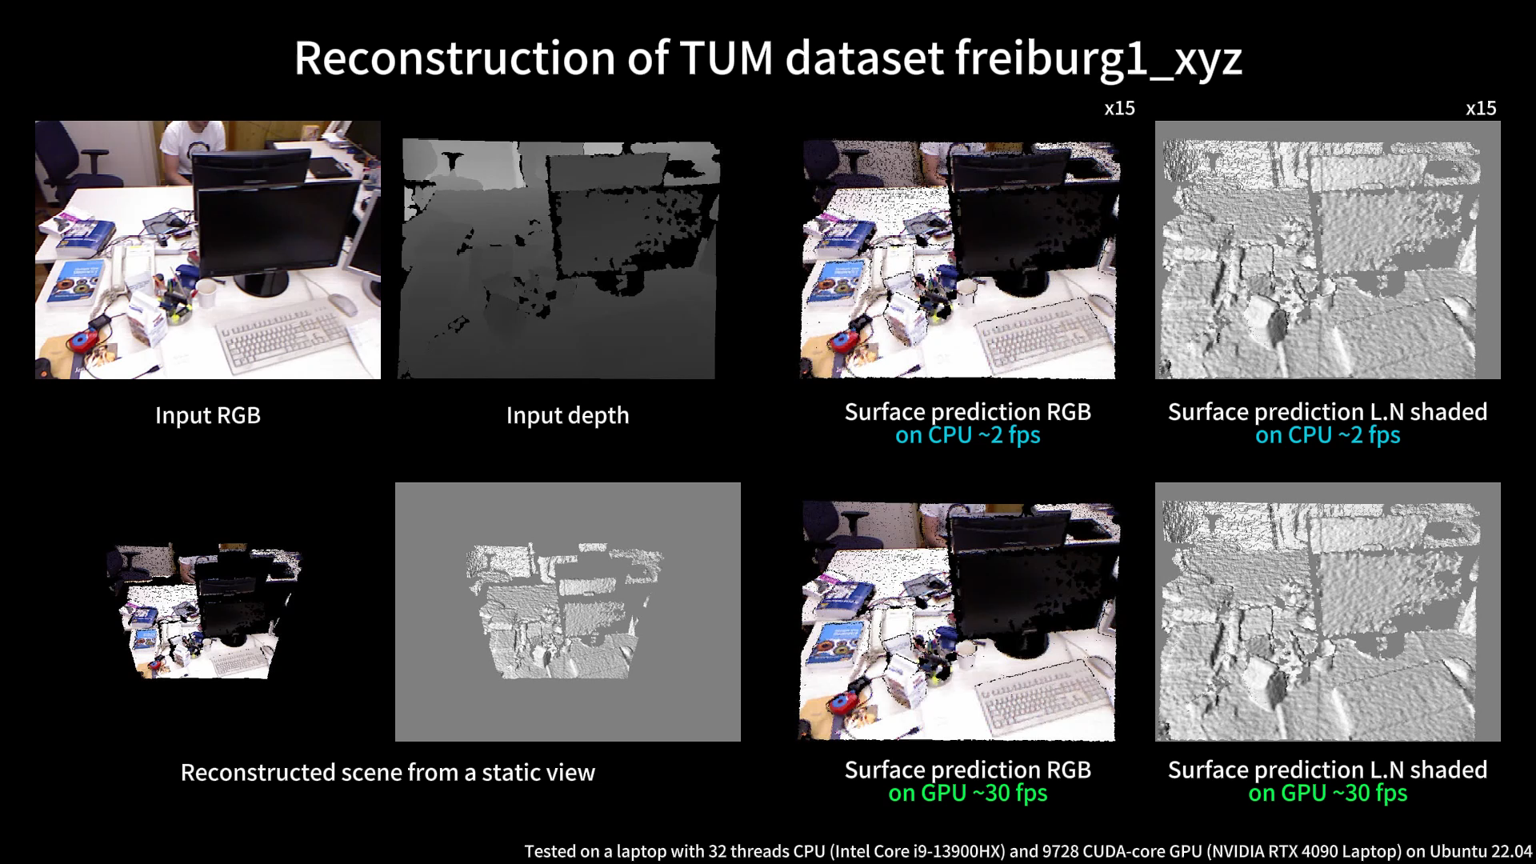

Slide 12
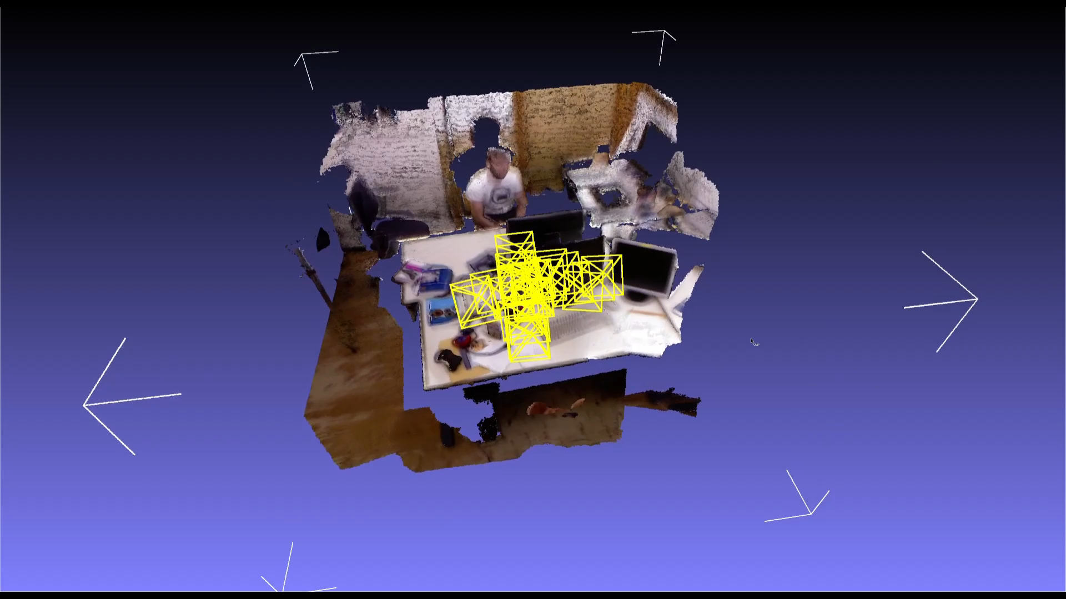

Slide 13
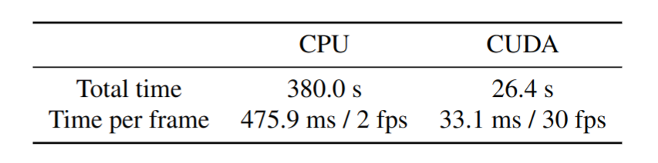
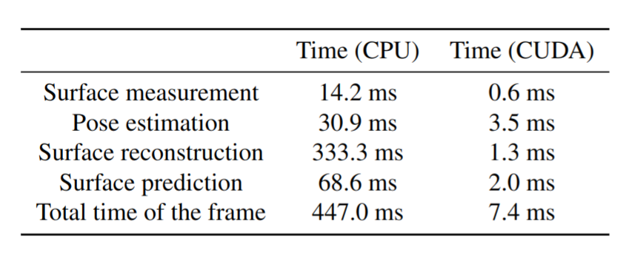
Analysis – Computation Time Comparison
Process all frames and per frame
(between CPU and CUDA implementation)
Each module in one frame
(between CPU and CUDA implementation)
14 times faster!

Slide 14
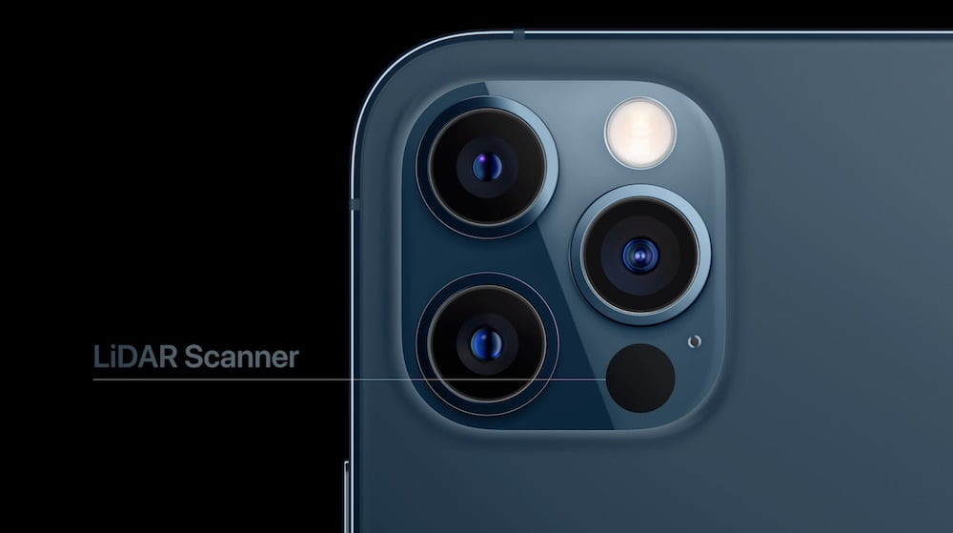


Experiment – iPhone LiDAR Sensor Data Stream
Record3D
Stream video of 30 fps to laptop
1440 x 1920 RGB map
192 x 256 depth map
Reconstruction of our apartment
https://mixed.de/iphone-12-pro-modelle-kommen-mit-lidar-sensor-doch-wozu/

Slide 15
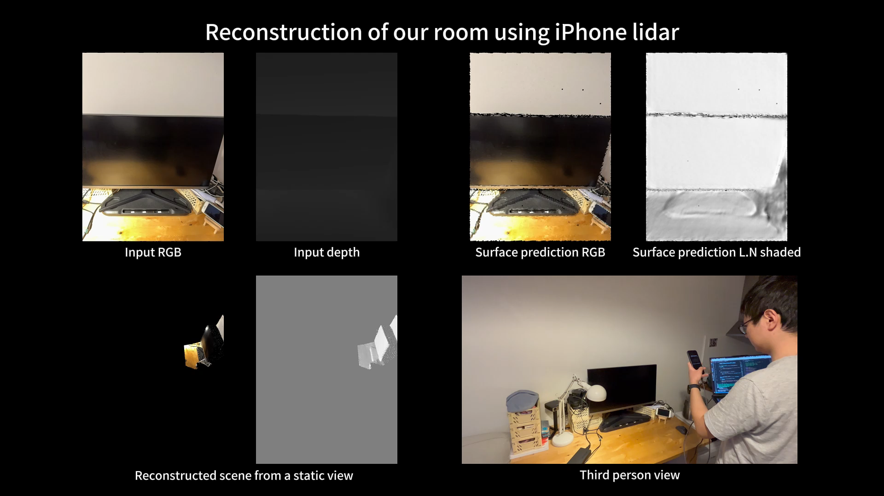

Slide 17
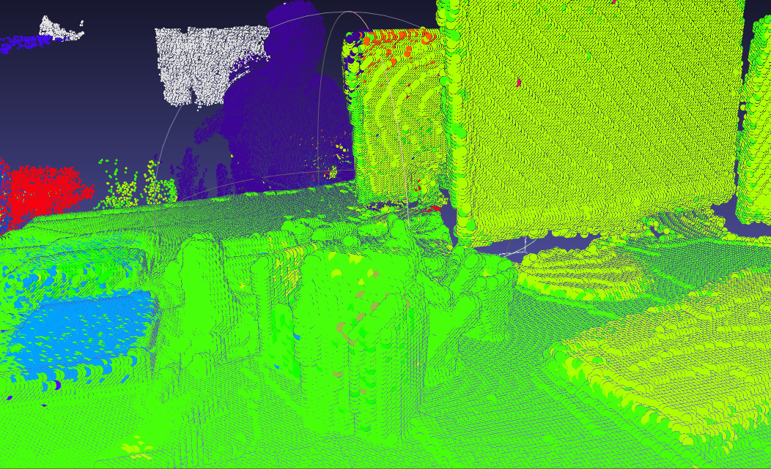
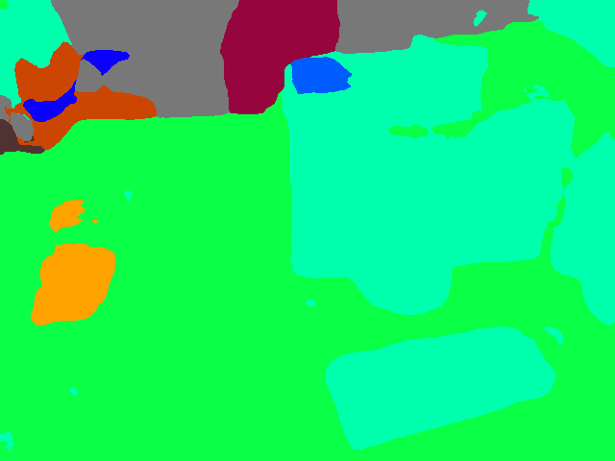
Experiment – Incorporating Semantic Information from 2D
2D Segmentation
3D volume

Slide 18
Experiment – Incorporating Semantic Information from 2D
Voxel i,j,k
 | 0 | 1 | 2 | 3 | 4 | 5 | 6 | 7 | 8 | 9 | 10 | 11
2d class | 16 | 16 | 16 | 35 | 35 | 35 | 35 | 35 | 35 | 12 | 35 | 35
weight | 0 | 1 | 2 | 3 | 2 | 3 | 4 | 5 | 6 | 7 | 8 | 9
Probability to accept new class | 1 | - | - | 0.3 | - | - | - | - | - | 0.14 | - | -
3D class | 16 | 16 | 16 | 35 | 35 | 35 | 35 | 35 | 35 | 35 | 35 | 35

Slide 19
Experiment – Incorporating Semantic Information from 2D
Why segmentation?
Better semantic understanding for scene (Navigation applications)
ICP Correspondences finding.
Use 3d information to remove noise from 2d segmentation (neighborhood in 3d can be assumed to have same class but in 2d it's not the case)
Extend same implementation to map static scene with moving classes (human) by excluding them.

Slide 20
Conclusion
Thank you for your attention!
Any questions?
KinectFusion on both CPU and GPU frameworks
High efficiency and advantages of GPU parallel computation in 3D reconstruction tasks
Significant performance enhancement with CUDA implementation
Real-time 3D scene reconstruction at 30 FPS
14x speed increase compared to CPU-based approach
Detailed environment reconstruction using iPhone LiDAR streaming
Incorporated 2D semantic segmentation to improve reconstruction quality

Slide 21
Addition – Surface Reconstruction
Volume Indices
Voxel size
Global coordinates
Camera coordinates
Pixel coordinates
Pose
Intrinsics

Slide 22
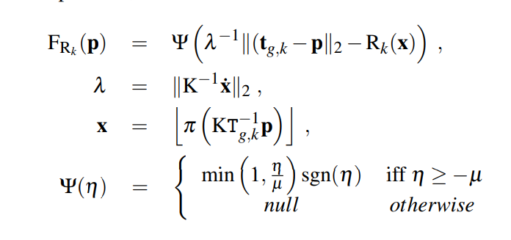
Addition – Surface Reconstruction

Slide 23
Thank you for your attention!
3DSMC – KinectFusion (Team 9)
Xuyuan Han
Mohamed Kotb
Feng Yang
Shengchao Zhang
München, 13. February 2024

